Slide 1
THE PASTOR’S WIFE AND HER DRESS
Gloria Trotman, PhD
Notes:
NOTE: This material addresses the specific challenges of pastoral wives. For the husband of a female pastor, feel free to glean any wisdom that applies to your situation.

Slide 2
“The wife of a minister of the gospel can be either a most successful helper and a great blessing to her husband, or a hindrance to him in his work . . . Their dress should be an example.” The Adventist Home, p. 355
Notes:
Read slide.
Slide 3

Slide 3
Dressing dilemmas
What to wear?
What not to wear?
Where to wear it?
What you hope to achieve?
Notes:
Whenever we have to go out, there are certain questions on our minds:
What to Wear
What not to wear
Where to wear it
What you hope to achieve
Slide 4

Slide 4
The Importance of Dress
People judge us by our appearance. Our appearance can affect our performance.
We have only one chance to make a good first impression.
By our dress, we represent Christ.
“Their dress should be an example.” Adventist Home p. 355
Notes:
People judge us by our appearance. Our appearance can affect our performance. We have only one chance to make a good first impression. By our dress, we represent Christ.
Slide 5

Slide 5
“A person’s character is judged by his style of dress. A refined taste, a cultivated mind, will be revealed in the choice of simple, appropriate attire.” Education, p. 248
Notes:
He looks good and she does not.
He looks bad and she does not.
Neither looks good.
Slide 6

Slide 6
The pastor
“A minister who is negligent in his apparel often wounds those of good taste and refined sensibilities. . . .The loss of some souls at last will be traced to the untidiness of the minister. 2T 613
Notes:
Better to have a few good suits than a lot of cheap outfits.
Notice how the priests were instructed (in the OT) to dress. Exodus 28: 2. “And thou shalt make holy garments for Aaron, thy brother, for glory and for beauty.” “Make sacred garments for your brother, Aaron to give him dignity and honor.’ NIV
Slide 7

Slide 7
The occasion/people vs you
The occasion is more important than you.
“Our clothing should be plain and simple so that when we visit the poor they will not be embarrassed by the contrast between our appearance and their own.” Gospel Workers, p. 189
Notes:
Read slide.
Slide 8

Slide 8
Critical details
Place
Time
Occasion
The other people at the event
Notes:
Read slide.
Slide 9

Slide 9
What is your body shape?
Straight?
Pear?
Spoon?
Hourglass?
Inverted triangle?
Oval?
Diamond?
Find out your body shape and choose
clothes that suit your shape.
Notes:
Read slide.
Slide 10

Slide 10
Straight Body Shape:
The bust and hips are basically the same size.
Pear Body Type:
The hips are larger than the bust, and the waist gradually slopes out to the hips.
Notes:
Straight body shape. Proportionally dress the top and bottom of your body while enhancing your waist. Pear body type: The hips are larger than the bust, and the waist gradually slopes out to the hips.
Slide 11

Slide 11
Spoon Body Type:
The hips are larger than the bust and the hips have a “shelf” appearance.
The Hourglass Shape:
This is the shape women would tend to die for. The bust and hips are basically the same size and your waist is well defined.
Notes:
The key to dressing a Spoon body type is to draw attention to your upper body while deemphasizing your tummy and hips to create a more balanced appearance and create the illusion of an hourglass figure. Tops with empire waists.
Off the shoulder, boat-neck tops, wide V or U necks.
Tops with ruching or embellishments around the bust.
Slide 12

Slide 12
Flattering fabrics?
Heavy, coarse material makes us look fat.
Shiny material, satin, velvet make us look bigger.
Gabardine, cotton knit, not-shiny material look good on everyone.
Notes:
Read slide.
Slide 13

Slide 13
Sheers, ruffles, frills add size to our bodies
Clothes that cling to our bodies show our real size-- Too large or too slim.
Notes:
Read slide.
Slide 14

Slide 14
Determining our Style and Taste in Clothes
Age
Job
Spouse’s position
Notes:
Read slide.
Slide 15

Slide 15
The importance of color
Color influences how we feel and how others feel.
Quiet, calm
Cheerful
Notes:
Read slide.
Slide 16

Slide 16
Color captures the attention of others.
The color test
Other people’s comments
Your own feelings
Notes:
Read slide.
Slide 17

Slide 17
Accessories
Anything that is more than our basic outfit – suit and blouse, or dress
The popular Point System (11 – 13 points )
If you assign points to each item of your dress, you will hardly be over-dressed. Gloves, ornaments, bows, and buttons all get points.
Less than 8 points = under-dressed
Think about what fits your personality.
Think about the mood you want (business, casual, party going, beach)
Notes:
Read slide.
Slide 18

Slide 18
Dressing without much money
Activity: If you had only $800 to upgrade your closet, what kinds of clothes would you buy for your job? For church?

Slide 19
Basic accessories
Quality of clothes
Basics for your closet
Mix and match
Notes:
Read slide.
Slide 20

Slide 20
Dressing at home
Comfortable
Attractive
Suitable
Not scary
Notes:
Read slide.
Slide 21

Slide 21
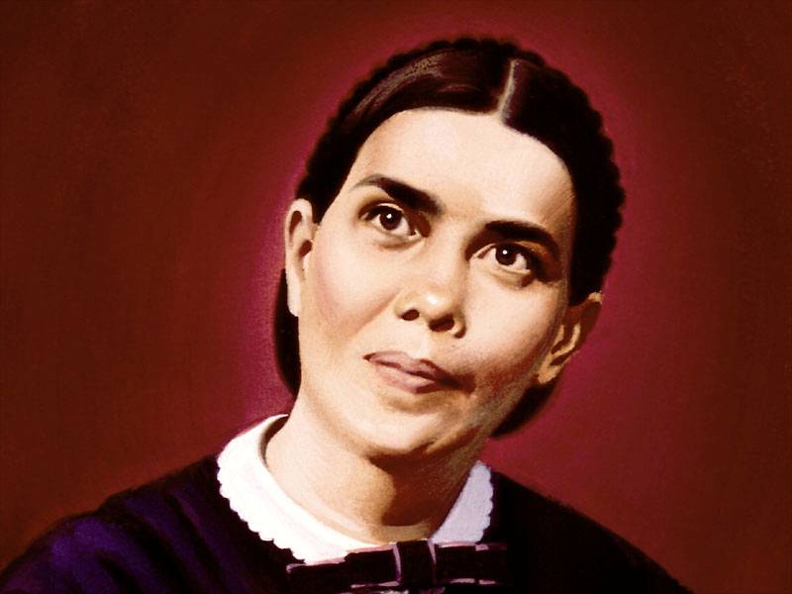
“Sisters, when about their work, should not put on clothing which would make them look like images to frighten the crows from the corn.”
Adventist Home, p. 252, 253
Notes:
Read quote.
Slide 22

Slide 22
The modesty test
The most important thing for us to think about is, “Is this modest?”
1 Timothy 2: 9, 10
Notes:
In like manner also, that women adorn themselves in modest apparel, with shamefacedness and sobriety; not with broided hair, or gold, or pearls, or costly array;
¹⁰ But (which becometh women professing godliness) with good works. 1 Tim. 2: 9, 10.
Slide 23

Slide 23
Modesty Test
Too low?
Too high?
Too clingy?
Too defined?
Notes:
Read slide.
Slide 24

Slide 24
Underwear
That is just what it is: not to be seen. Watch those hipster trousers!
Buy well fitting, seamless bras.
Check your bra size from time to time.
Notes:
Read slide.
Slide 25

Slide 25
Helpful aids for fashion sense
Take a short sewing class.
Browse through reputable fashion magazines.
Plan your wardrobe carefully.
Know your personality tastes.
Notes:
Read slide.
Slide 26

Slide 26
Helpful aids for fashion sense
Choose age appropriate styles.
Choose bargains with care.
Spend carefully.
Do not be a slave to fashion.
You do not have to wear every fashion.
True beauty comes from within.
Notes:
Read slide.
Slide 27

Slide 27
The Ultimate Dress
Christ’s robe of righteousness
The beauty of Jesus in our hearts and lives will be the best adornment for our dress.
1 Peter 3: 3
Notes:
Whose adorning let it not be that outward adorning of plaiting the hair, and of wearing of gold, or of putting on of apparel. 1 Peter 3: 3

Slide 28
The Pastor’s Wife and Her Dress
Gloria Trotman, PhD

